Slide 1

Quantum you know
By QuantumEts Bis
Pacôme Gasnier – Antoine Lemelin – Xavier Bergeron – Robin Heng

Slide 2


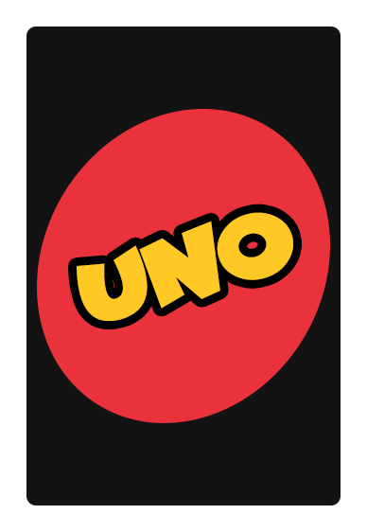


Why Uno ?

Slide 3
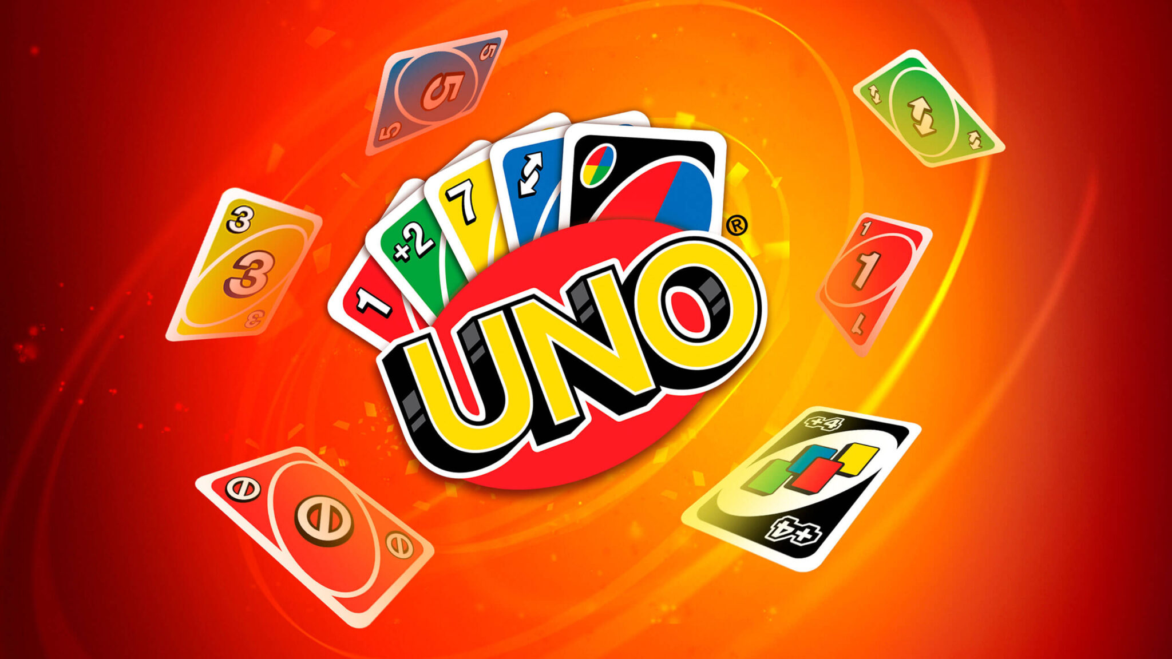
Uno classical mechanics

Slide 4
Main mechanics
Goal is to get rid of all your cards before the others
Need to play a card with the same value or color as the previous one
Some cards have special effects
Possibility of stacking drawing cards (Contentious)
If you can’t play you draw a card
When it’s your last card you have to shout « UNO »

Slide 5
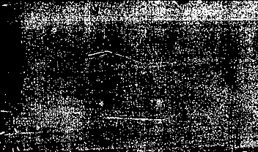
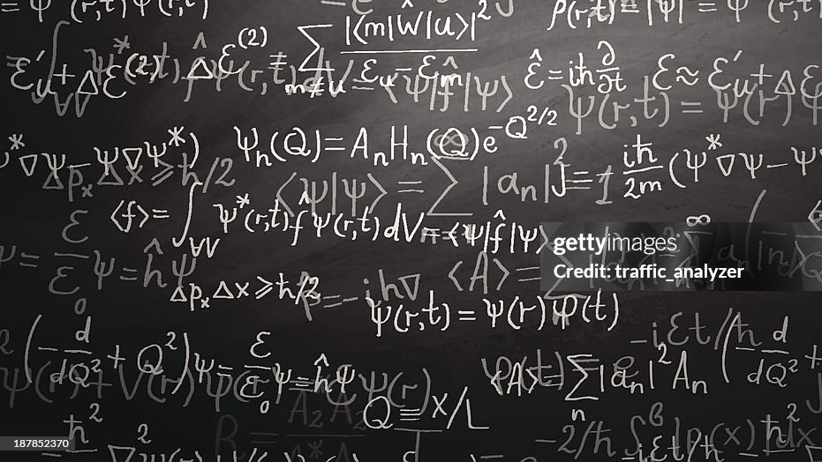
Time for some Quantum

Slide 6
What we kept from the classical game
The colours
The numerical values
The seven starting cards
The multiplayer aspect
And that’s it

Slide 7
Where did we add Quantum
Initialization of the game
Winning condition
Bots to play with
Special cards

Slide 8
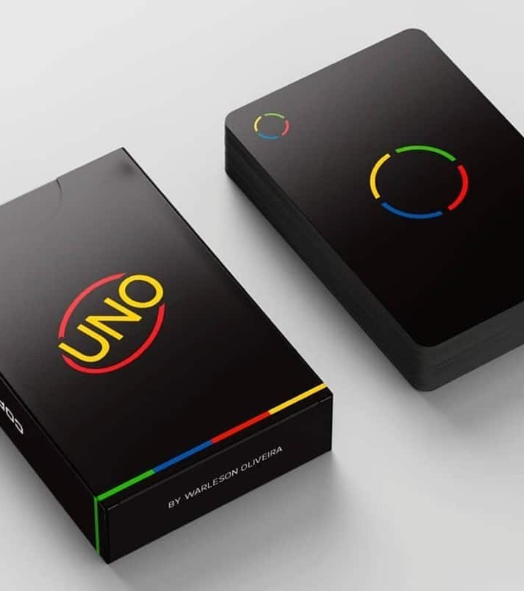
Initialization of the game
Quantum shuffling
Generate a quantum random number with an Hadamard tower to shuffle the deck with

Slide 9
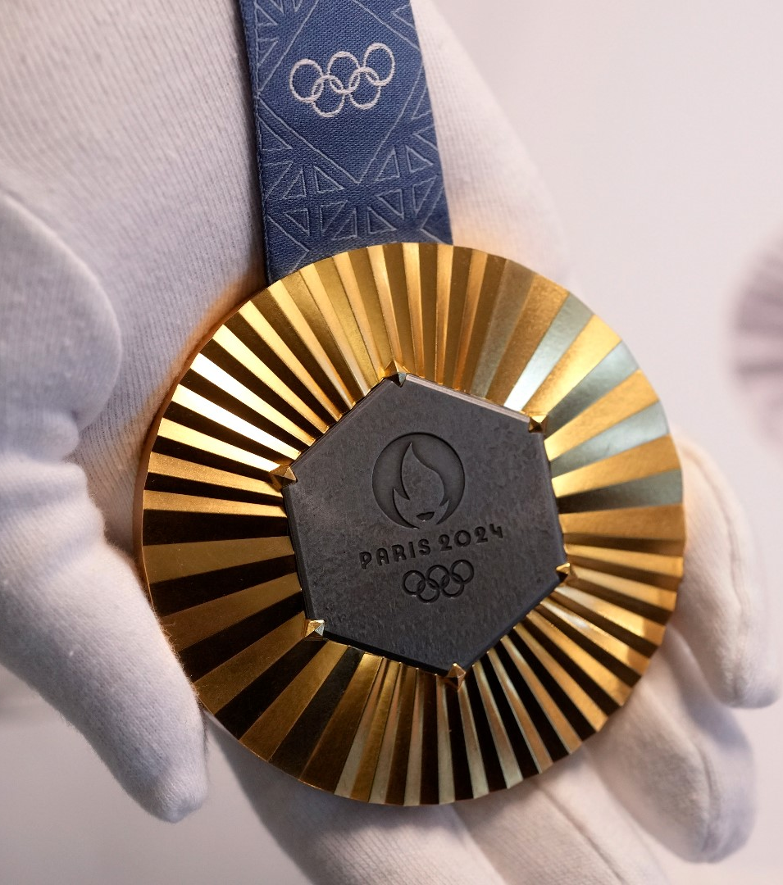
Winning condition
When a player has 0 cards left
A quantum circuit is executed to measure the player register
The result collapses to the winning player's index
This identifies the winner using quantum readout

Slide 10

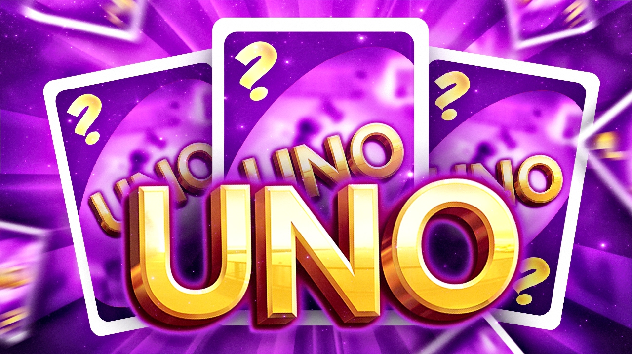
Special cards
Random drawing card
Search card
Hand shuffling card
Teleportation card
Hand swapping card
Superposed card
Color changing card
Balancing card
Trading card
Funny card

Slide 11

Random drawing card
Calculate a quantum random number to decide how many cards the next person will draw between 0 and 7

Slide 12
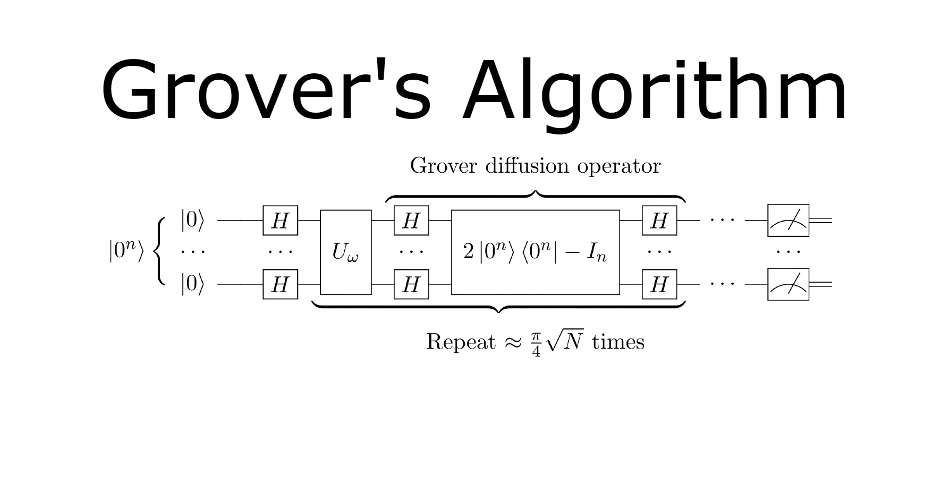
Search card
Uses Grover algorithm
You choose a card in your hand
The algorithm searches through all hands if someone has a card with the same value
Every person that has the said card draws a number of card equivalent to the position of the card

Slide 13
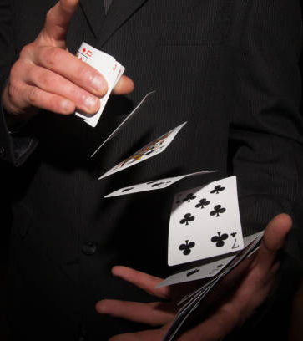
Hand shuffling card
Takes all the players card
Uses a quantum random number to shuffle the cards
Redistributes almost the same number of cards to all players

Slide 14
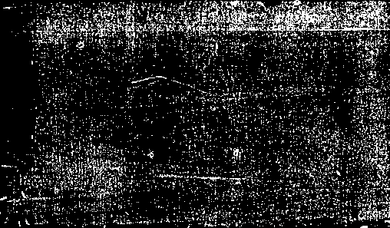
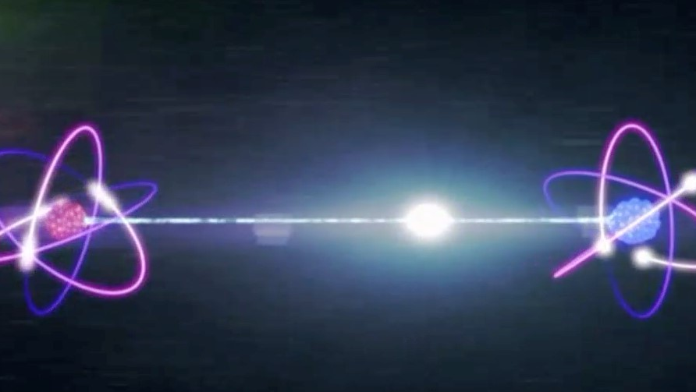
Teleportation card
Uses a bell measurement to determine the amount of cards to be teleported
Swaps the corresponding amount of cars between the player and the next player (from 0 to 3)

Slide 15
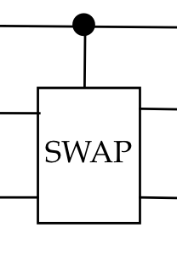
Hand swapping card
Maps the hands of two players to qubits
Use controlled swap gates
All the qubits to 1 go to the first player, all the qubits to 0 go to the second player
This allows to swap cards between the two players

Slide 16

Superposed card
Uses superposition so you don’t know the card value until you play it.
When played it can take any card value randomly

Slide 17
Color changing card
Allows to change to one of the four colors possible
Represents the four colors as a graph of four states to use the quantum walker algorithm
The state you finish on determines the color to be played

Slide 18
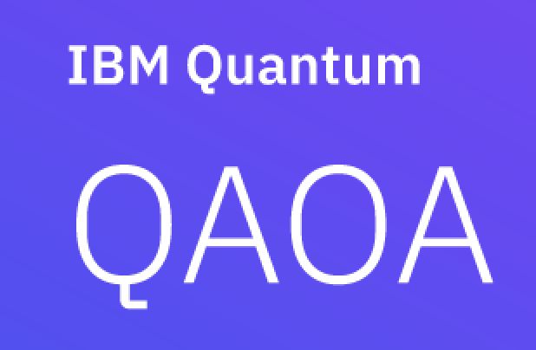
Balancing card
Takes the hands of two players
Uses QAOA to output two hands a similar sum of card values

Slide 19
Trading card
Draws two cards from the deck
Uses Lemelin’s algorithm (QAOA variation) to determine the two weakest cards
Disposes of the two weakest cards

Slide 20
Funny card
Uses a superposed qubit
Based on the state measured
Either pass the turn of the next player
Either reverse playing sense

Slide 21
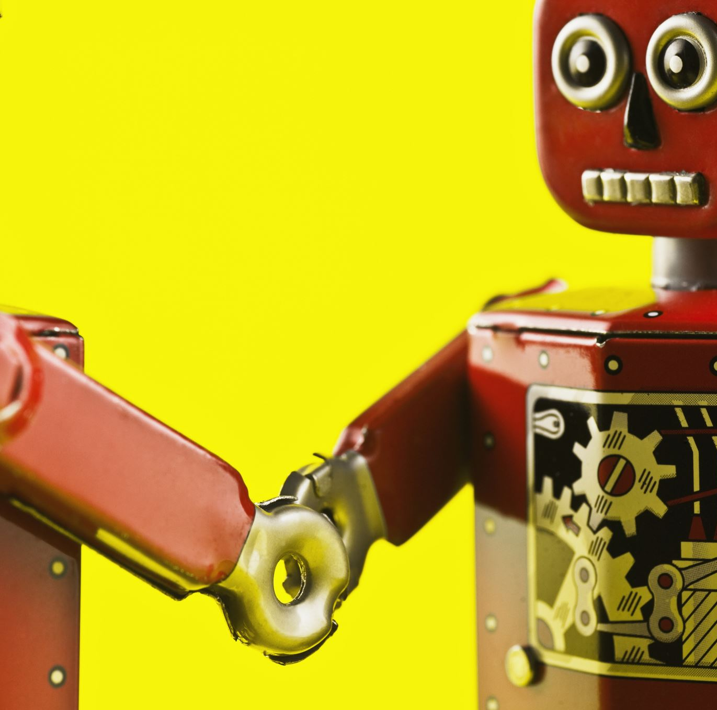
Bots to play with
Uses QAOA to decide which action to take

Slide 22

Quantum bot
Formulates a QUBO - Based on card weights and playability
Uses QAOA to optimize - Quantum Approximate Optimization Algorithm
Runs quantum circuit to sample - Finds most likely bitstring for best move
Measures & Decides → If 1 appears → Play that card → If 0s only → Fallback to best-weight card

Slide 23

Demonstration

Slide 24
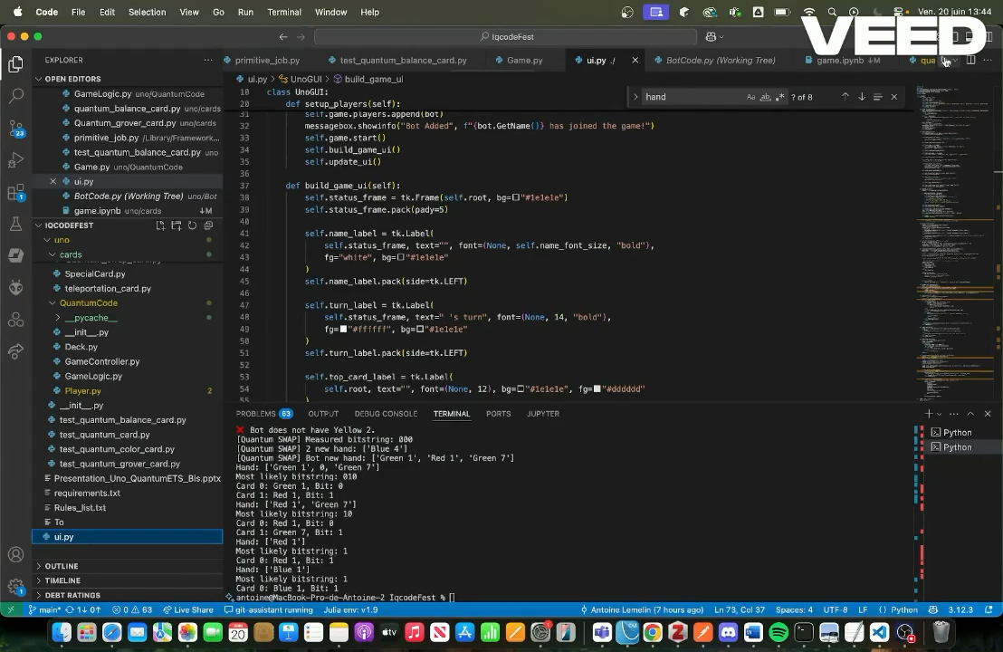

Slide 25
Merci beaucoup!

Slide 26

Ways of exploration

Slide 27
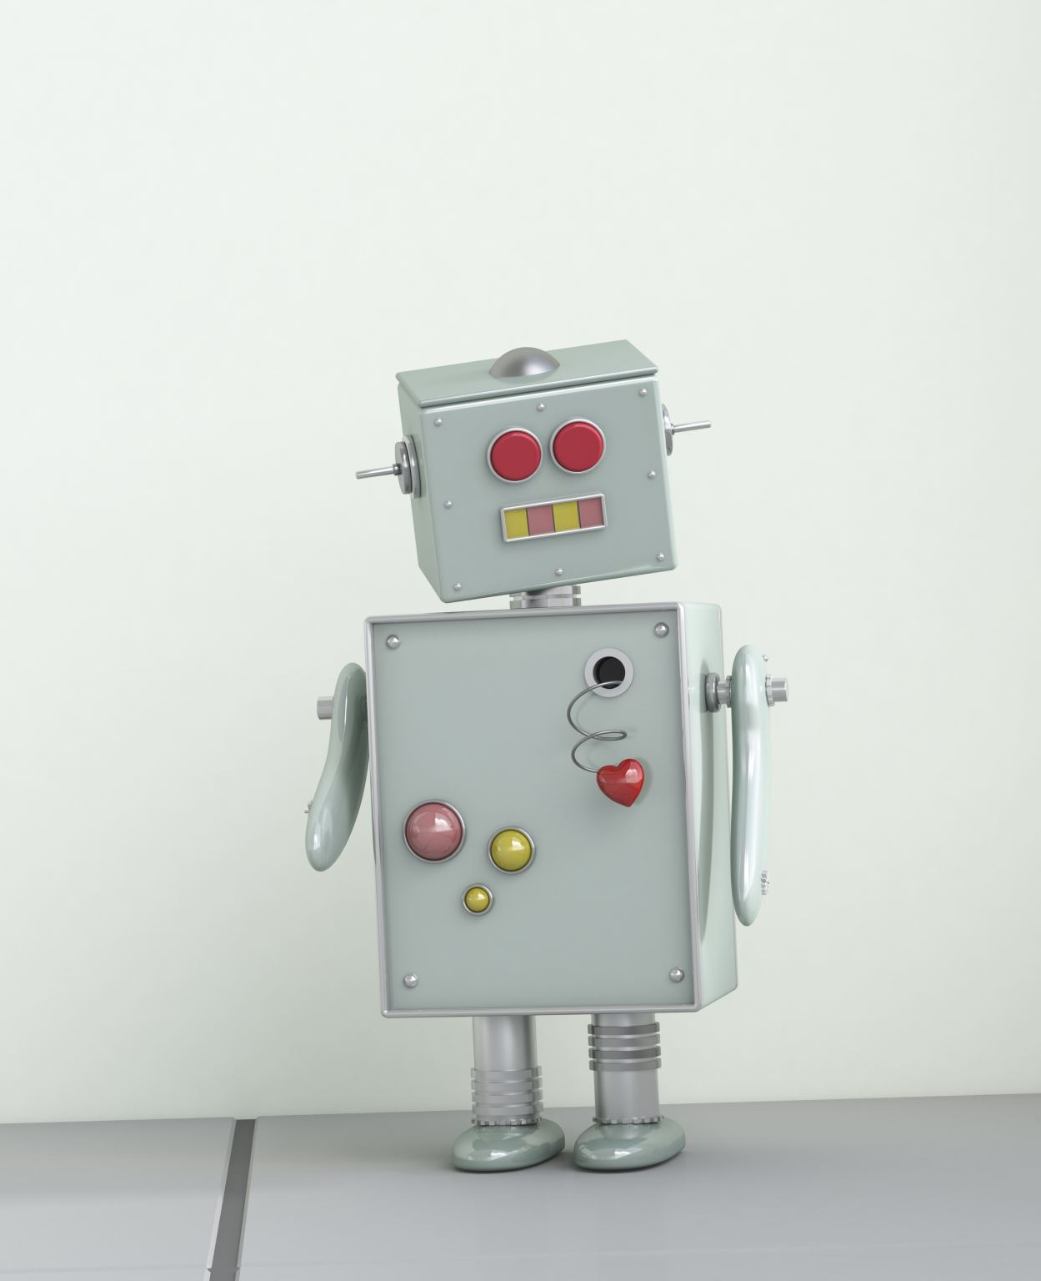
Add a second level bot

Slide 28
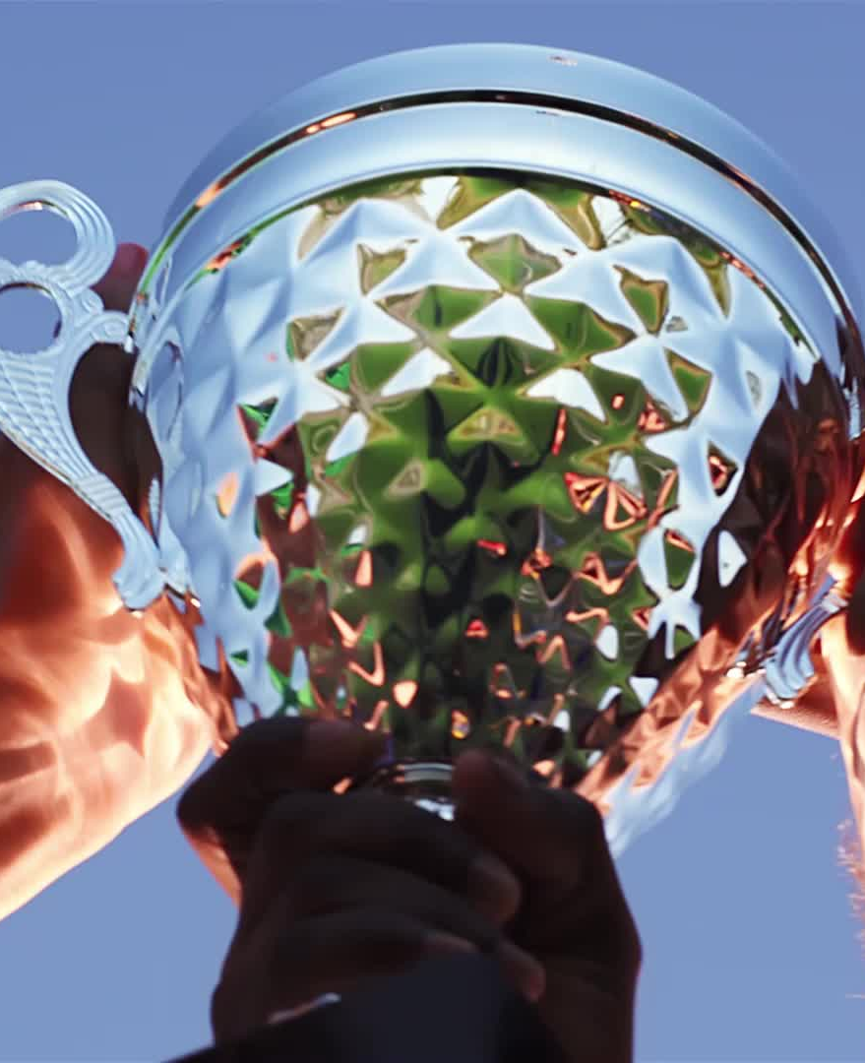
Develop enough bots so they can play together and the spectator can bet on the winner

